Slide 1
STEP 8 – TESTING AND RELEASE
The really exciting bits…

Slide 2
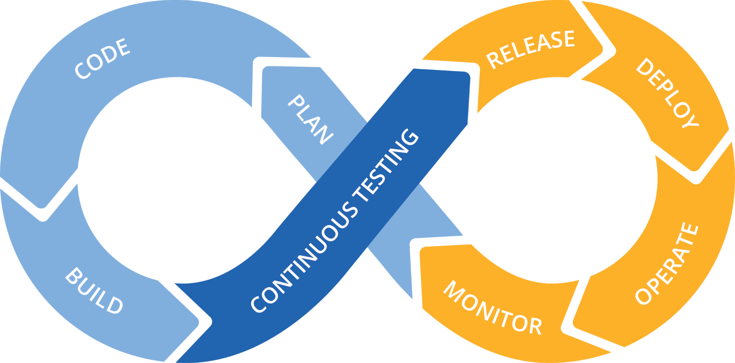

Step 8 Test & Release App Cycle
Why is testing important? Because users are too…
They break what’s there
They ask for what’s not there
They use what’s there for something completely different
They complain about things you never knew existed until they complained

Slide 3
Step 8 Test & Release App Cycle
When it comes to release time you have a few options:
Cloud release (£££)
Web hosting (££)
Host from home (£)

